Slide 1

Theoretical Fit
Mykola Chernyashevskyy

Slide 2
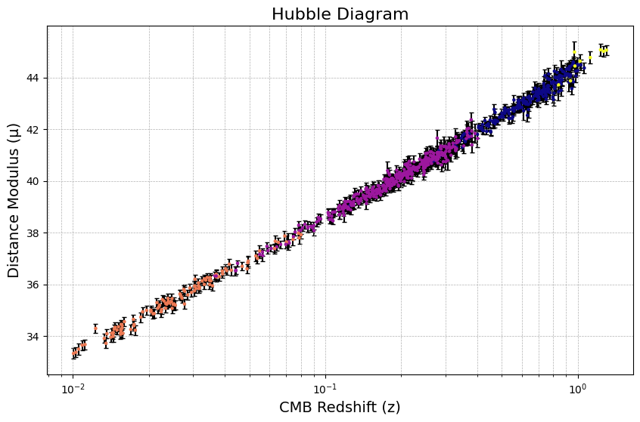
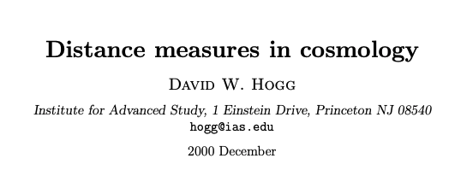
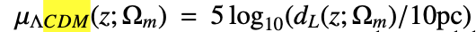
Last Meeting

Slide 3
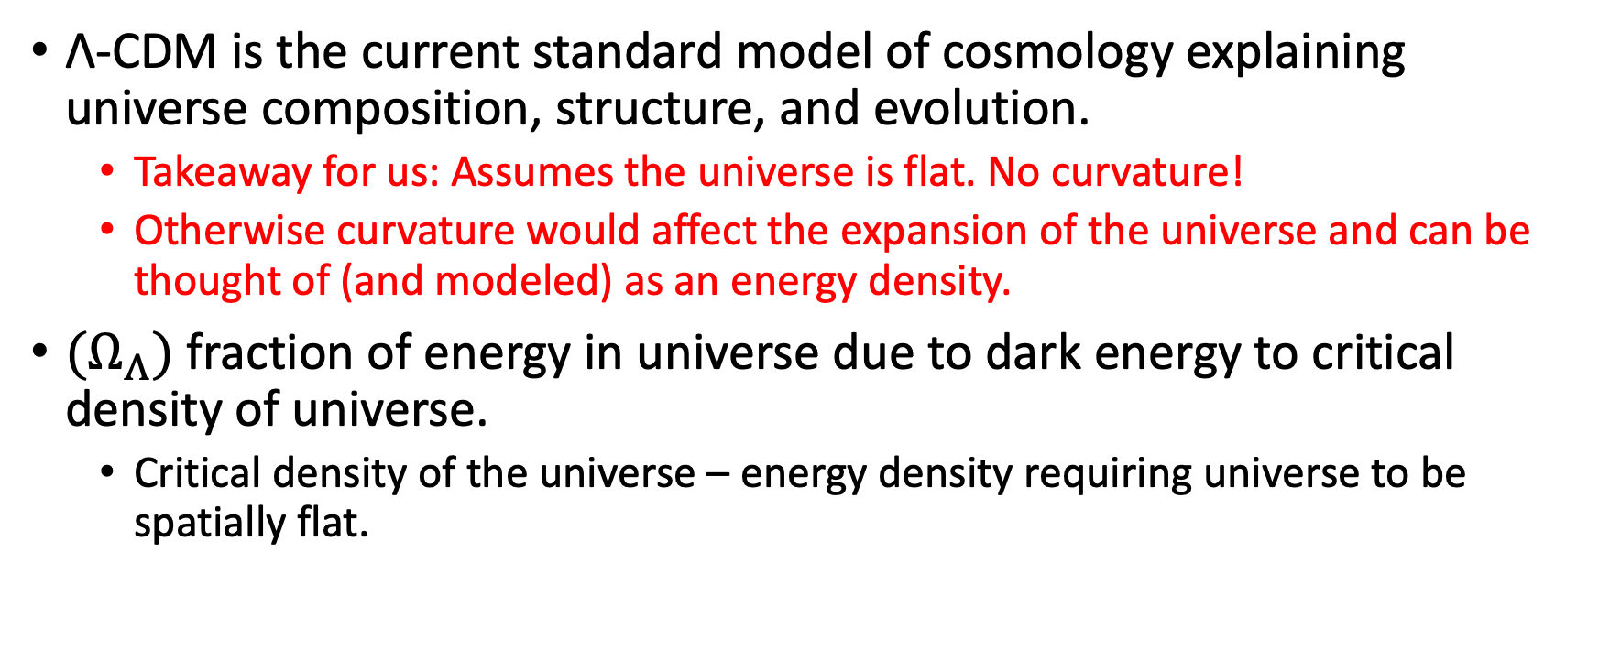
Λ-CDM Model (Lambda Cold Dark Matter Model)
Λ-CDM is the current standard model of cosmology explaining universe composition, structure, and evolution.
Takeaway for us: Assumes the universe is flat. No curvature!
Otherwise curvature would affect the expansion of the universe and can be thought of (and modeled) as an energy density.
${(Ω}_{Λ})$ fraction of energy in universe due to dark energy to critical density of universe.
Critical density of the universe – energy density requiring universe to be spatially flat.

Slide 4
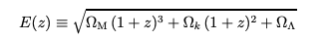
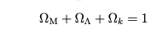
D. Hogg Paper Derivation of
From Λ-CDM:
Planck Satellite
NOTE: reference distance of 10 parsecs from earth.

Slide 5
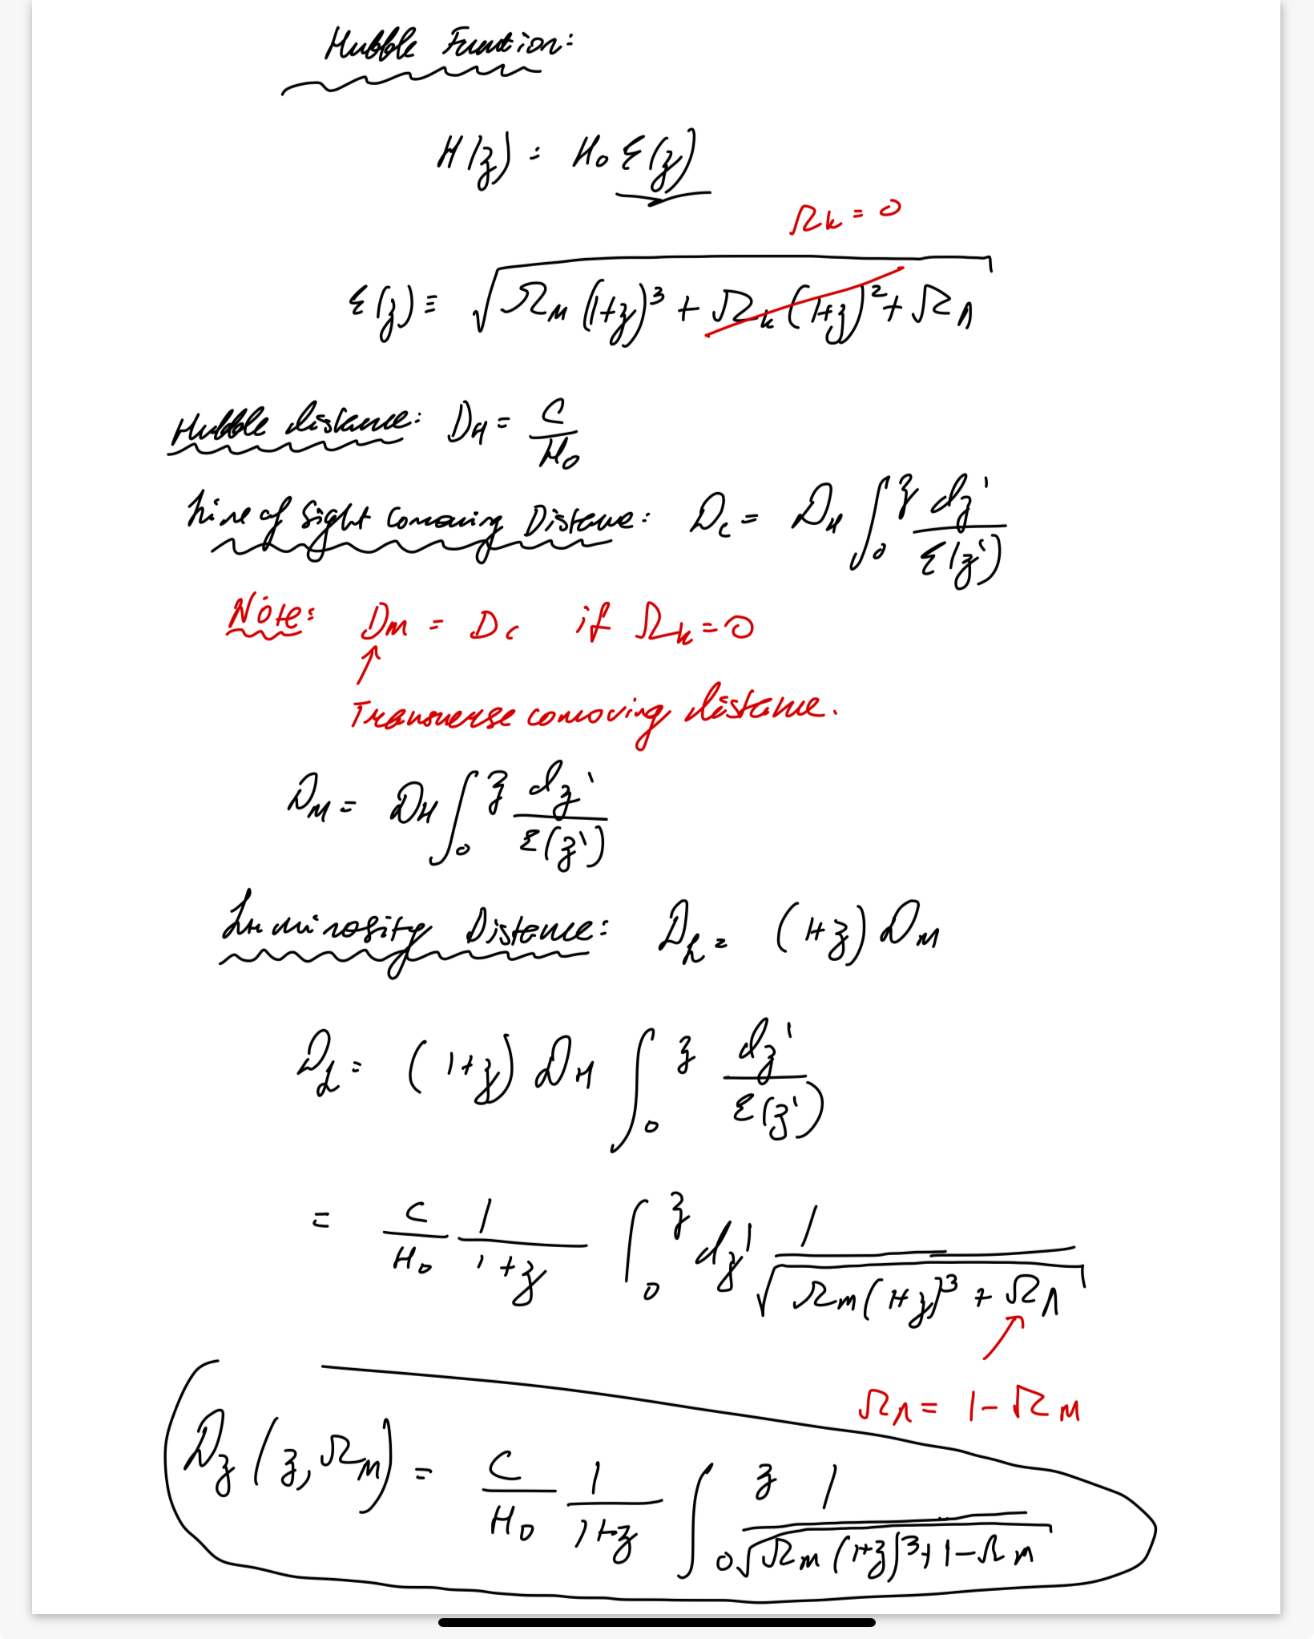
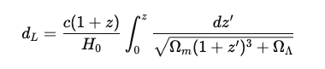
D. Hogg Paper Derivation Continued
1 – Omega_m
Plug this back into the following equation for each
galaxy:

Slide 6
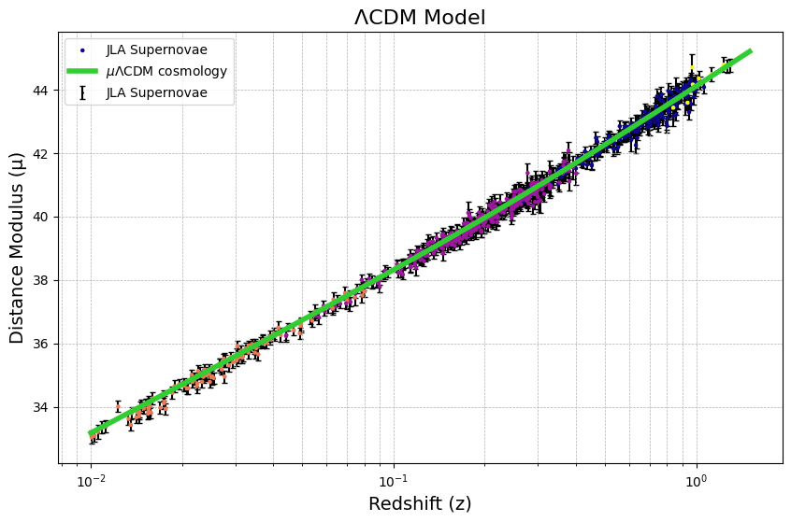
Model Fit

Slide 7
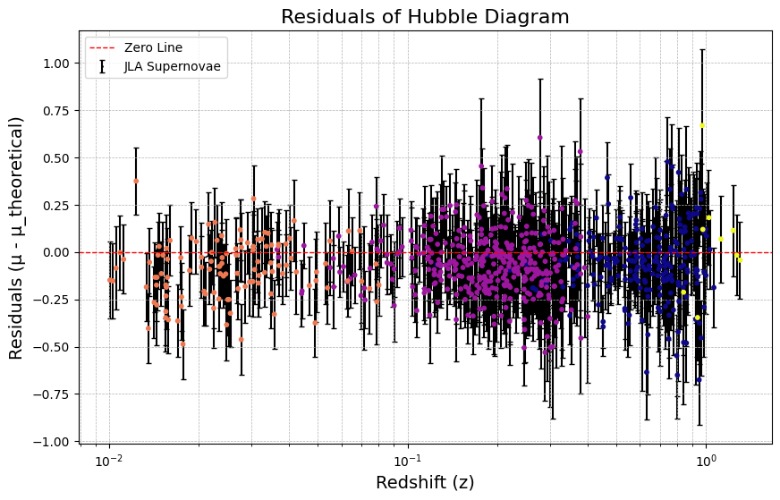
Residuals – How we Judge Accuracy of Fit

Slide 8
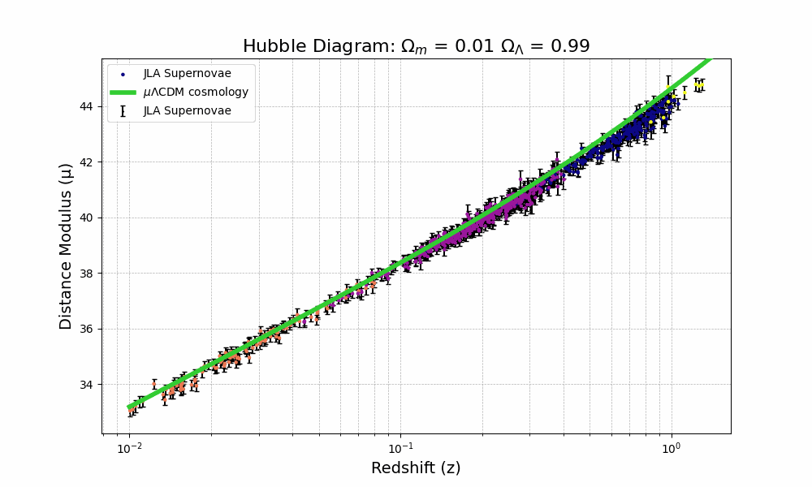
For Kyle – Animation – Not a Standard Line Fit

Slide 9
Residuals Calculations

